Slide 1

Authentication in Angular
Mark A. Wilson Senior Developer MarkW@LogicalAdvantage.com
www.DeveloperInfra.com @DeveloperInfra

Slide 2

Mark A. Wilson
www.developerinfra.com
@DeveloperInfra
Notes:
17 notable references in Wikipedia.

Slide 3


Logical Advantage
www.logicaladvantage.com
Notes:
Business cards up front.

Slide 4
Modern Applications

Slide 5
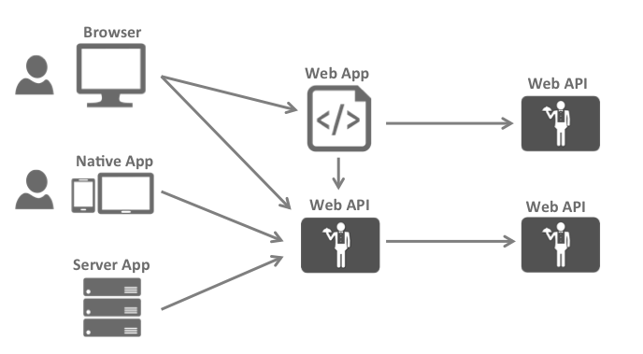
The Big Picture
https://identityserver.github.io/Documentation/docsv2/overview/bigPicture.html

Slide 6
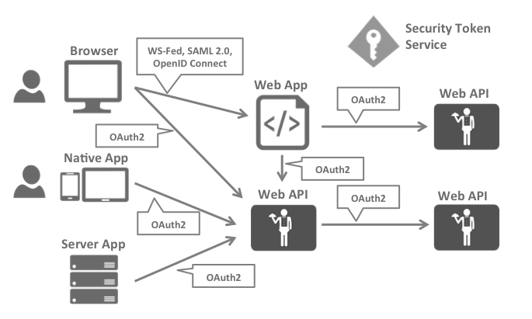
Security Protocols
https://identityserver.github.io/Documentation/docsv2/overview/bigPicture.html

Slide 7

OpenID Connect
“OpenID Connect 1.0 is a simple identity layer on top of the OAuth 2.0 protocol.”
Defines identity tokens
Defines standard token type
Defines standard cryptography
Defines validation procedures
Defines flows for browser, native, and server-based apps
Combines authentication with short/long-lived delegated API access
http://openid.net/connect/

Slide 8
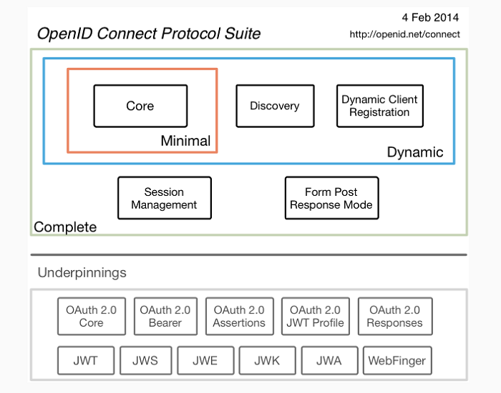
OpenID Connect
http://openid.net/connect/

Slide 9



OpenID Connect
Authorize Endpoint
Token Endpoint
UserInfo Endpoint

Slide 10



Flows
Client Credentials Flow
(Server-to-Server/IoT)
Implicit Flow
(Browser-based)
Hybrid Flow
(Native/Mobile)

Slide 11
Implicit Flow
GET /authorize
?client_id=app1
&redirect_uri=https://app.com/cb
&response_type=id_token
&response_mode=form_post
&nonce=a1b…x9z
&scope=openid email

Slide 12
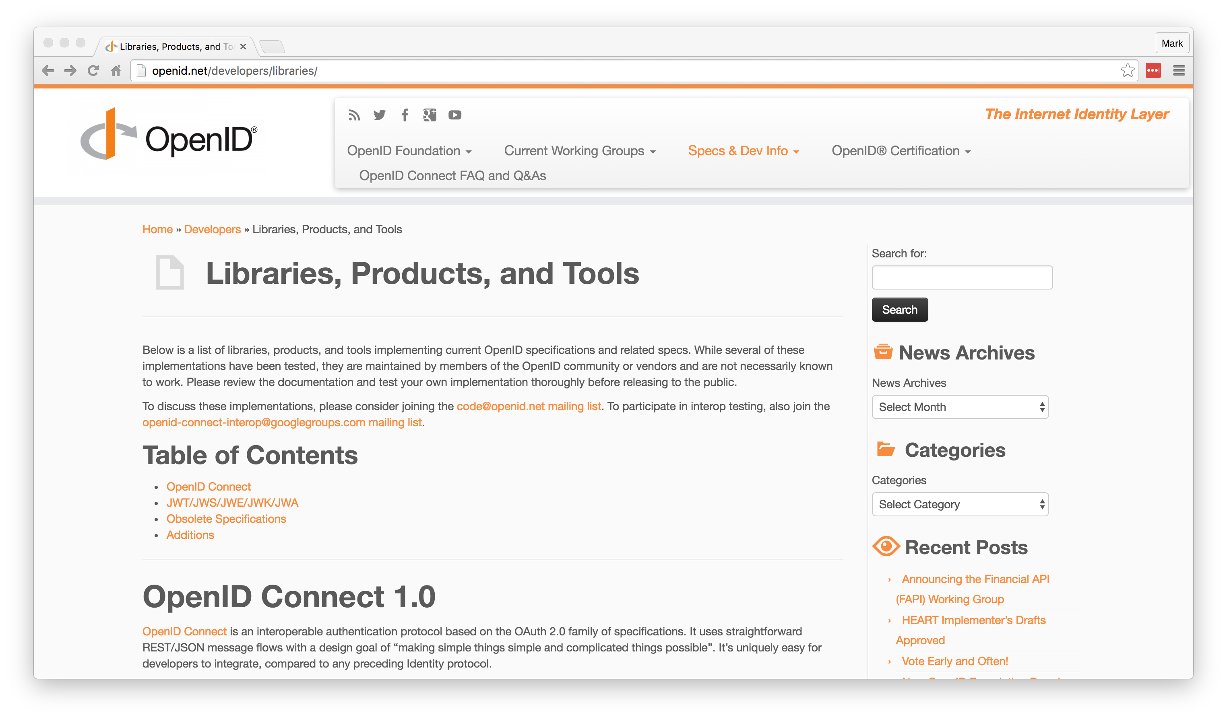
Getting Started
http://openid.net/developers/libraries/

Slide 13
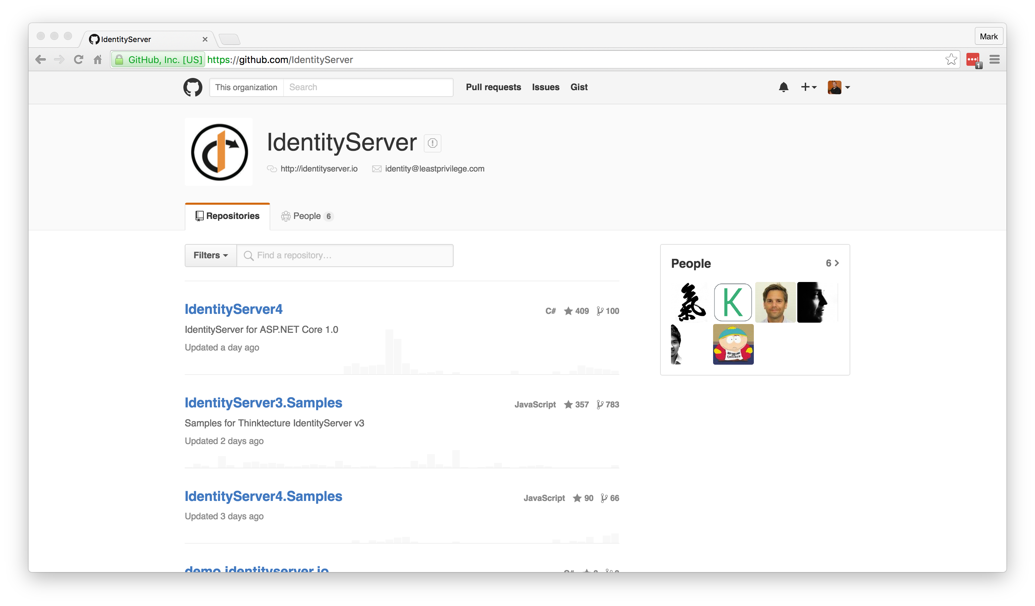
Getting Started
https://github.com/IdentityServer

Slide 14
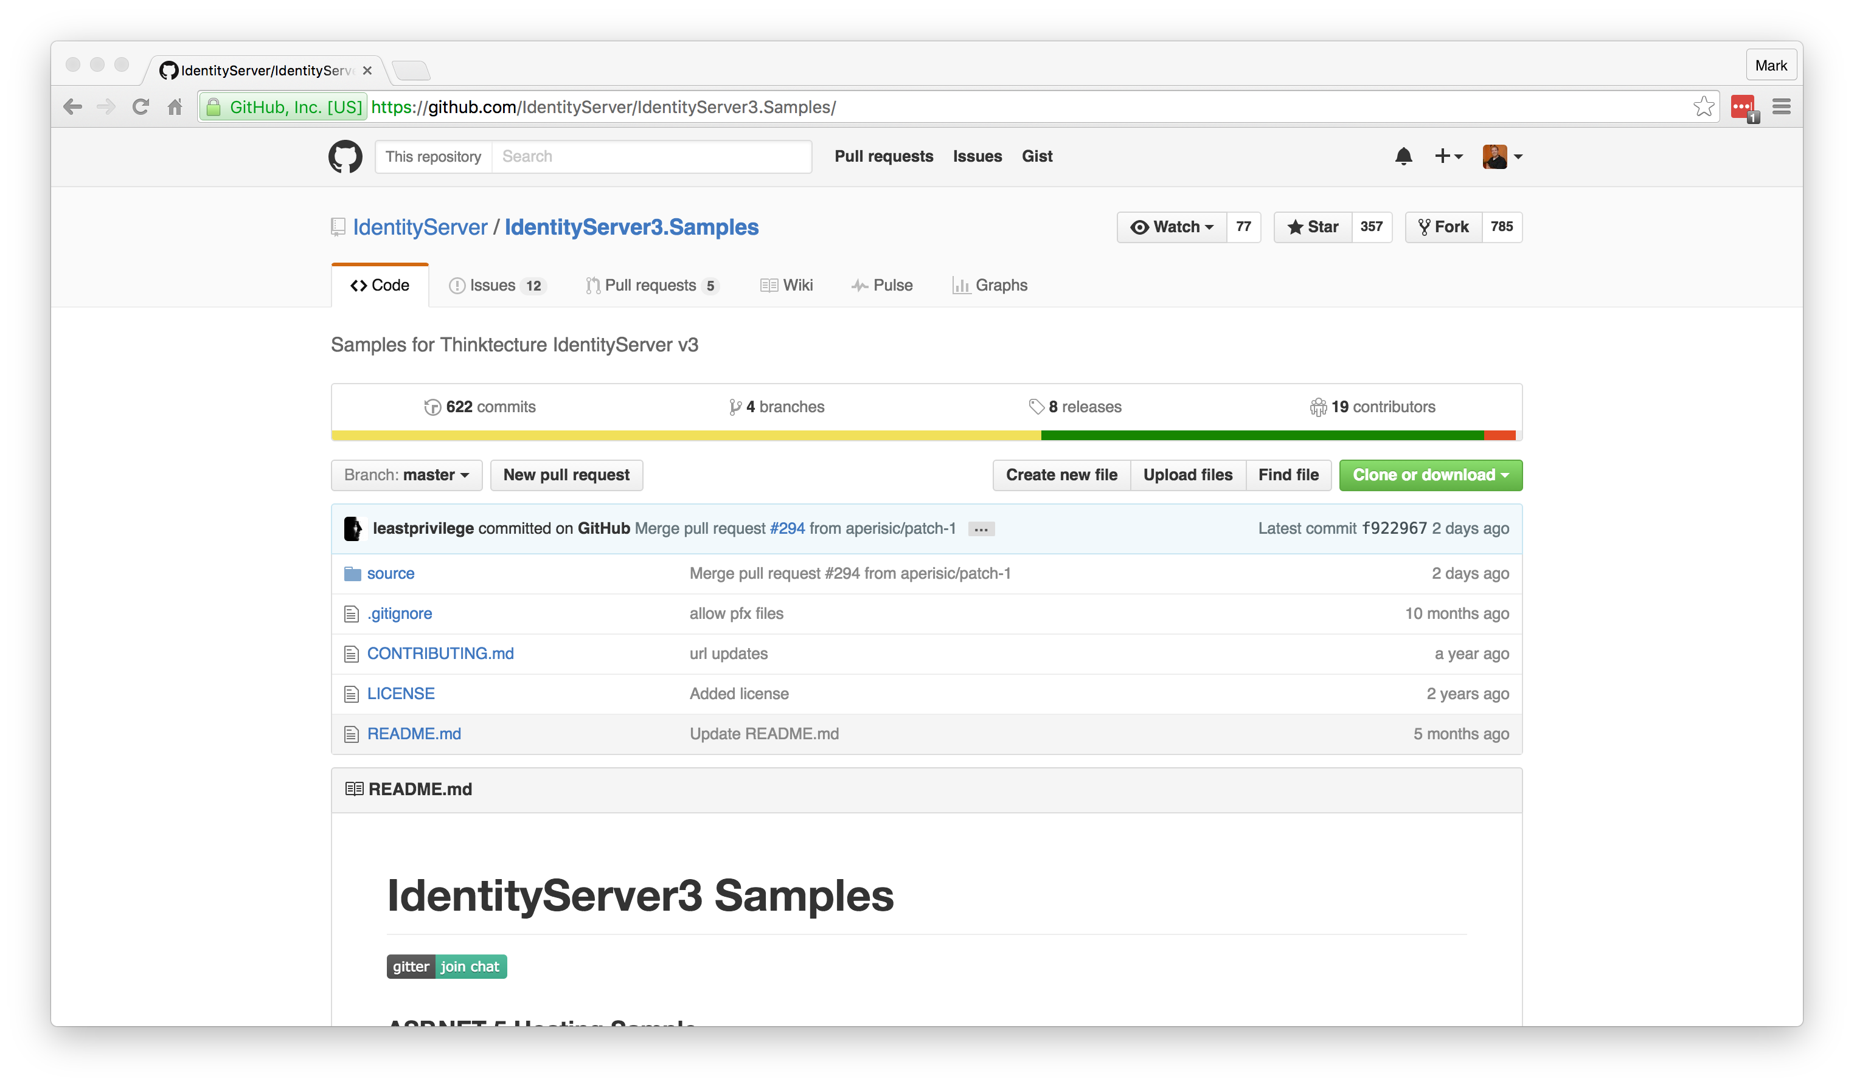
Getting Started
https://github.com/IdentityServer/IdentityServer3.Samples/

Slide 15


Authentication in Angular
DEMO

Slide 16
Resources
OpenID Connect: http://openid.net/connect/
OpenID Connect Libraries: http://openid.net/developers/libraries/
IdentityServer: https://github.com/IdentityServer
IdentityServer Samples: https://github.com/IdentityServer/IdentityServer3.Samples/
JSON Web Tokens: https://jwt.io/
Notes:
HTTPS: Use it!
Forms Auth: Happy path, easiest to setup. Transmits in clear text.
3rd-Party Logins: All implemented differently. Takes time.
Custom Grant Type: Forms vs. 3rd-Party take separate paths.
Entity Framework: Everything uses it by default.
Production Ready: Maybe not public-facing. Very little validation/checking.

Slide 17
Authentication in Angular
Mark A. Wilson Senior Developer MarkW@LogicalAdvantage.com
www.DeveloperInfra.com @DeveloperInfra

